Slide 1
Segmentation Review Tool
Benjamin Green

Slide 2
Discussion points
Overlap table and saved data
Changes to the UI
Next steps
A short demo of where the UI is now for additional comments
Notes:
I thought it might be best to start talking about the overlap table and what kind of data is saved. I just want to be sure that everyone is on the same page here. Then we could go through changes in the UI and what next steps for those changes are. Last I wanted to show a short demo of where the tool was now to aid in giving additional comments

Slide 3
Generating Overlap Table
For each cell in a overlap pair, divide overlapped pixels by total pixels in that cell to compute fractional overlaps
Define cell objects in both image types
(IF and superpixel\ SP)
Compute pixel overlap of objects from one image type to the other
Remove pairs with joint overlap of less than .1, mark pairs with joint overlap of .8
Multiply fractional overlaps for a pair to get joint overlap
Find cells for each type that are not yet paired and add those to the table
Notes:
I thought it would be good to talk about the information I am keeping from the slides so that we are all on the same page.

Slide 4
Table format
IF_cellid | IF_X_centroid | IF_Y_centroid | SP_paired_w_IF | SP_cellid | SP_X_centroid | SP_Y_centroid | IF_paired_w_SP
cellid | IF_level | Joint_overlap | class_selection | cell_check | flags
Descriptions of ambiguous columns explained in next slides
I also save the drawn cell objects in a label matrix defined by the cellids shown here as the comparison_seg_data.tif

Slide 5
Ambiguous column descriptions:
SP_paired_w_IF and IF_paired_w_SP:
The cellid in the first type which corresponds to the current cellid of the second, serves as an additional coding check that the correct cells are paired. SP_paired_w_IF == SP_cellid and IF_paired_w_SP == IF_cellid.
IF_level:
The level or type of segmentation performed from inform
(1) immune segmentation
(2) tumor segmentation
Joint_overlap:
joint fractional overlap, from multiplying the fractional overlaps of each type

Slide 6
Ambiguous column descriptions cont.:
Class_selection:
Which type of segmentation to include
(0): not yet defined
(1): Inform type
(2): super pixel type
(3): drawn on
(4): joint overlap over .8 and set NOT to review
(5): reviewed as both
(6): added \ new cell
(-1): neither segmentation chosen and not drawn
(-2): artifact
Cell_check:
Whether or not that cell will be reviewed
(0): do not review (see (4) in class selection)
(1): review
(2): joint overlap over .8 and set to review

Slide 7
Ambiguous column descriptions cont. cont.:
Flags:
(1): Multi nucleated
(2): Flagged for review by user

Slide 8
UI changes

Slide 9
Changes since last iteration
Additional error checking when saving the results tables for improved performance.
Improved on drawing capability
Randomly switch between IF and superpixel approaches as A or B
Cell counter in the UI now removes ‘non reviewed cells’ to avoid confusion
QC 20% of .8 joint overlap pairs,
if the user selects more than 5% of those as something other than ‘A = B’; the rest of the .8 pairs will be added for review.
Improved user interface
Notes:
On saving:
it seemed like some folks were having issues with the saving, this was an immediate red flag since this work is tedious already. I added a saving progress bar to so they know when the saving is finished, this also servers to lock the users from being able click any more buttons and avoid unforeseen saving interruptions. I also using the time stamps in the files to confirm the file saving.
On Drawing:
The drawing tool has additional checks to make sure it does not get hung up, which seemed to happen often during the previous iteration.
On random switch: this is random for each time a cell is displayed.
On cell counter:
Previously the cell counter at the top of the UI counted off by cellids that were established as part of the overlap computation. This caused confusion since we were skipping highly joined cells, using those are agreed.
On overlaps:
I am not sure if a 5% disagreement is enough or if it is too small as a criteria. For some of these images we have about a 1000 of the overlap pairs, in that instance they would review an additional 200 cells. 5% of that would be 10 cells, so maybe we do something like 20% our 20% failed which would be 40 of the 200. I didn’t know what other folks thought about that.

Slide 10
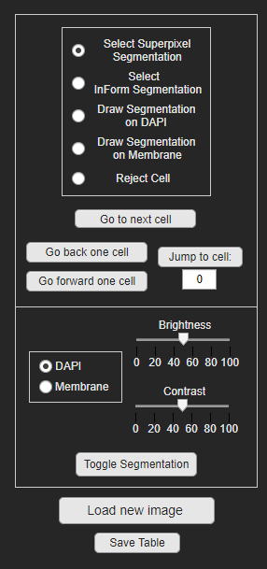
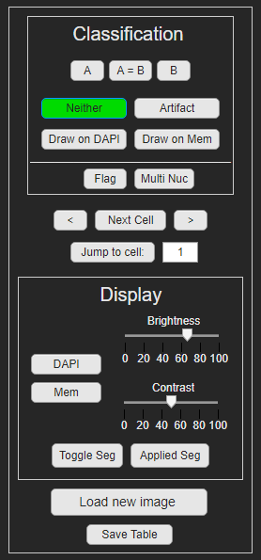
Improved UI
Notes:
Primarily we have removed the radio buttons for toggle buttons which change to green after the initial click.
We also add options in the cell classification for ‘Neither’ option: some issue where maybe both approaches mistakenly identify something, there is an ‘artifact’ class for tears or image issues, and there is an new ‘both’ option has been added or ‘A=B’ .
I also added a ‘Flag’ tag and a ‘MultiNuc’ tag, both of which are separate from the classification selection. And can be turned on simultaneously for a cell

Slide 11

Next Steps
Add cell segmentations to all cells in the images for the original segmentation of each respective type (A or B)
This would be applied with the ‘toggle seg' button
Allow user to view the currently applied segmentation of a given region using the ‘Applied cell’ button
Allow user to draw in new \ additional cells using an ‘Add cell’ button in the ‘flags section’:
Use a pop out window to draw the new cells, have the ‘Display’ settings available with keep, redraw, or reject options at the bottom once the user finishes drawing
When the UI finishes review show binarized DAPI (minus) final segmentation mask and allow user to ‘add new cells’

Slide 12
Initial startup
No old comparison result exists
Make a new overlap table and export initial table
Open next available cell
Start
Load Image
Lock UI
Old comparison result exists
Open old version
Create new version of overlap table and export with next ‘N’ subscript
If an image is already loaded run the ‘save protocol’

